Slide 1
GitHub Training Session
June 2020

Slide 2
Agenda
Distributed Versioning Control System (DVCS) Overview
Key Differences
GitHub Enterprise Setup
Setup Git Tools and Configuration
Git Internal Storage
GitHub – The remote repository
Creating Free Account
GitHub Glossary
GitHub API
Webhooks and Integrations
Setup Organization and Collaborators
Members and Roles
Team
Demo
Creating Repository
Markdown Overview
SSH Key Sharing
Forking and Cloning
Pull Request
Git Checkout
Commits
Using .gitignore
Branching and Merging
Idle Branching Strategy
Type of Merges
Fetch and Pull
Git Push
GitHub Issues
GitHub Project Kanban board
Demo
Demo
Demo
Demo
Demo
Demo
Demo
Demo
Demo
Demo
Demo
Demo
Demo
Demo
Demo
Demo
Demo

Slide 3
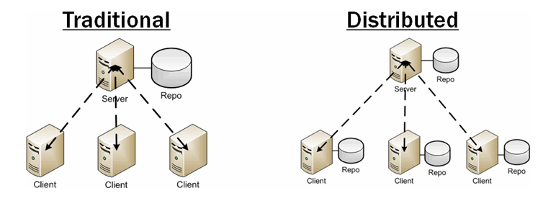
Distributed Versioning Control System (DVCS) Overview
DVCS?
In software development, distributed version control (also known as distributed revision control) is a form of version control in which the complete codebase, including its full history, is mirrored on every developer's computer. This enables automatic management branching and merging, speeds up most operations (except pushing and pulling), improves the ability to work offline, and does not rely on a single location for backups
Benefits
The Traditional version control systems(VCS) are centralized, which have a single server that contains all versions of the files. The clients check out files from that central server, edit them and then push it to the central server.
The Distributed VCS is the counterpart to traditional centralized VCS. In distributed systems, each client has a fully functional repository to work on, which can be merged with the server repository.
No network required
Faster operations
Allows private work without having to publish
Removes the risk of having the server be a single point of failure
Still allows centralized control of the server "release" version of the project

Slide 4
Key Differences
Checkout brings the entire commit history from remote repository in comparison to single version download from centralized version control system.
Option to work offline and bundle your changes into logical groups and create multiple commits from your staged code changes.
Avoid single point of failure as the entire version history copied as local repository in each developer system.
Branching in centralized version control system like svn creates separate folder structure within repository for every new branch whereas in Git branching is just a pointer to an specific commit point.
Working
Copy
Test.txt
add
Stage
Commit
Local
Repo
Push
Branch
Remote
Repo
Master

Slide 5
GitHub Enterprise Setup
GitHub Enterprise deployment requires involvement for GitHub Product team, Infrastructure team, and Platform Architect to work together and size the platform according to the requirement. The below sample architecture deployed in one of the leading Opening Banking customer serving close to ~5000 users.
Incoming Traffic
Architectural Decisions:
Performance
High Availability
Disaster Recovery
Security
Data Center - A
Data Center - B
F5 Load Balancer
Active - HTTPS
Passive - HTTPS
Zone-2
Zone-3
Zone-3
Virtual Intel 2 Core x 4 GB
Virtual Intel 4 Core x 32 GB
Virtual Intel 4 Core x 32 GB
RHEL 6.x
Utility Server
GitHub Backup Util
RHEL 6.x
GitHub Appliance
(80GB for OVA)
RHEL 6.x
GitHub Appliance
(80GB for OVA)
Backup
META / Data
Replication once/day
NAS 1024 GB
SAN
450 GB
SAN
450 GB

Slide 6
Setup Git and Configuration
Demo
Download link here → https://git-scm.com/downloads
Git client tools helps to work with local and remote repositories. The above package installs 3 tools for usage:
Git CLI
Git Bash
Git GUI
Extension for Eclipse / Visual Studio

Slide 7
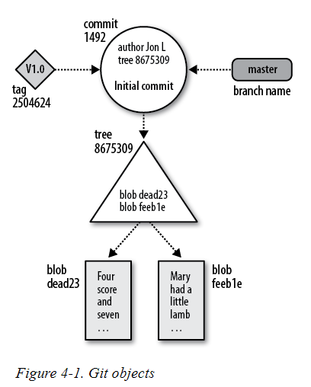
Git Internal Storage
Demo
Objects
Object Store | Description
Blob | Each version of the file created as a Blob
Tree | Directory structure, file names and META data stored as Blob
Commits | Every commit related information stored as blob object
Tags | Stores tags created by the developer
Index
the index captures a version of the project’s overall structure at some moment in time. Index file gets amended during staging and committing of code changes into repository.

Slide 8
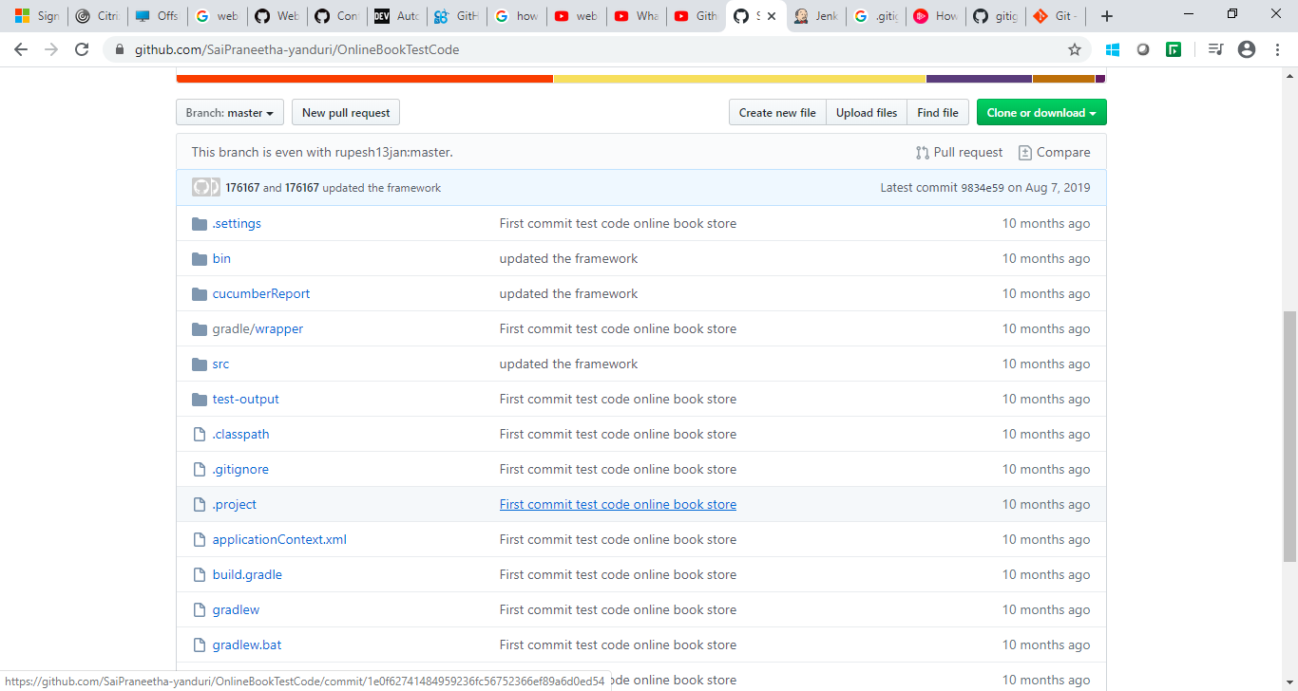
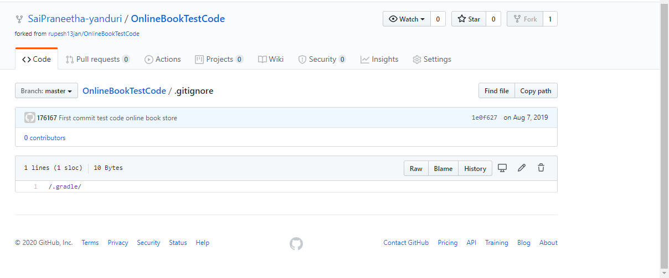
Using .gitignore
A gitignore file specifies intentionally untracked files that Git should ignore.
A . gitignore file is a plain text file where each line contains a pattern for files/directories to ignore. Generally, this is placed in the root folder of the repository.
We can also have multiple . gitignore files
Note: The gitignore file should contain the ignore files like jars, reports, war, files etc.

Slide 9
GitHub – The Remote Repository
This section dedicated to learning GitHub cloud.

Slide 10
Creating free account with GitHub
Demo
GitHub provides open source and free account in GitHub cloud repository. Anyone can signup with their own email id. Creating free account allows them to create any number of public repositories, collaborate and lookup other open source projects and much more…
The key use case is GitHub Cloud can play a role of remote repository for you and it can be integrate to your local repository to push changes back to cloud to share and collaborate with others.
Lets have a quick demo….

Slide 11
GitHub Glossary
Repository – basic element in GitHub, collective folder of code files representing a project (public and private)
Projects – Kanban board to coordinate, track and update work items.
Issues – suggested improvements, tasks, problems or questions related to the repository
Fork – Personal copy of another user’s repository
Clone – way to copy your remote repository to your local repository
Pull Requests – proposed changes to a repository (accepted or rejected by repository collaborators)
Actions – Customized work flow building for CI or CD task with openly available app plugins
Insights – Quick dashboard view on various metrics
Organizations – logic grouping of two or more users to create system level organization to group multiple repositories (Department / Functions)
Access token – used in place of a password over HTTPs
Branch – parallel version of a repository
Owner – Owner of the repository
Collaborator – a person with read and write access to a repository
Team – A group of organization members that reflect your company or group
Commit – a revision
Markdown – simple formatting option to create help documents
SSH Key – way to identify yourself to an online server, using an encrypted message
Pre-receive hooks – Scripts that run on the GitHub Enterprise server that you can use to implement quality checks (Sonar PR Scanner / SEDATED)
Webhooks – allow you to build or setup GitHub Apps which subscribe to certain events in the repository

Slide 12
GitHub APIs
Demo
GitHub provides REST API service to pull information from Git Repository. The complete reference of GitHub REST API can be found under below link.
https://developer.github.com/v3
Projects, Repositories, Commits, Issues, Pull Requests….

Slide 13
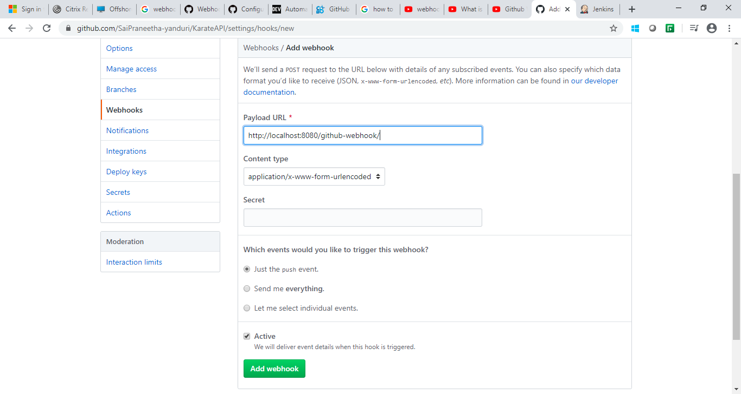
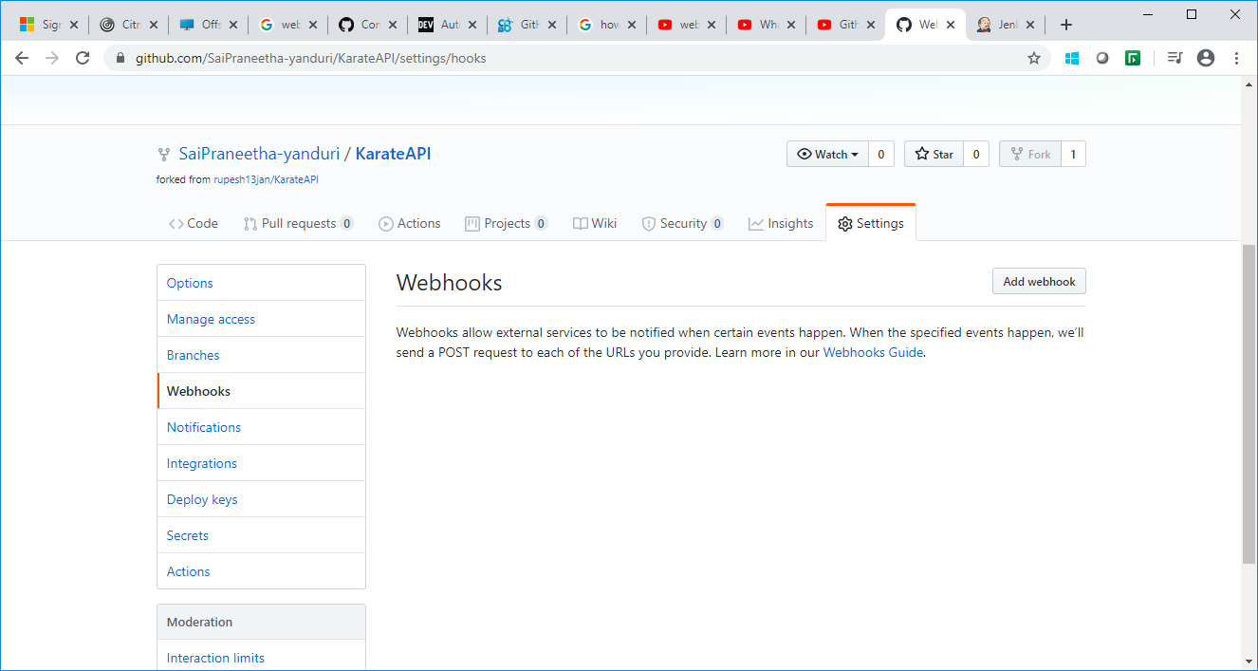
Webhooks and Integrations:
When configuring a webhook, you can use the UI or API to choose which events will send you payloads.
Example for Jenkin Integration in Webhook payload:
Click on “Add Webhook” and configure the jenkin URL in Payload URL
Once we click on “Add webhook”, the hook will create for corresponding payload jenkin. Whenever the push event is done in github the jenkin job will automatically trigger.
We can create the webhook based on event like push,commit,forks etc by selecting “Let me select individual events”

Slide 14
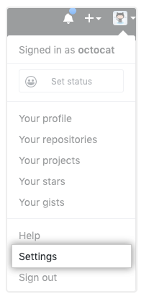
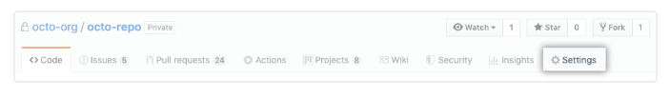
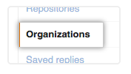
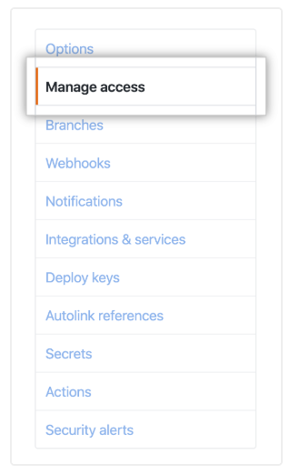
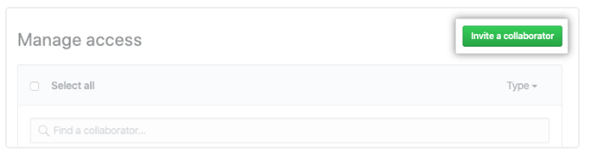
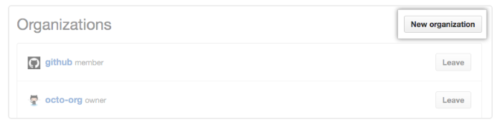
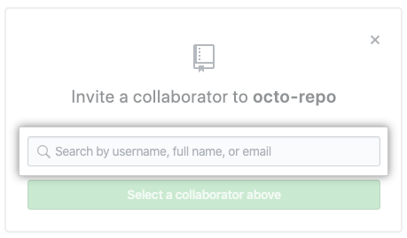
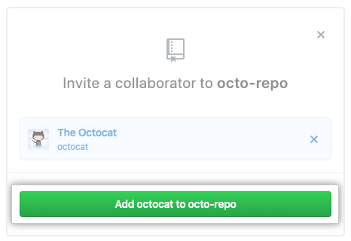
Setup Organization, Collaborators
Demo
Organization
Collaborators
Organizations are shared accounts where businesses and open-source projects can collaborate across many projects at once. Owners and administrators can manage member access to the organization's data and projects with sophisticated security and administrative features.
A collaborator is someone on the core development team of the project and has commit access to the main repository of the project.
Ask for the username of the person you're inviting as a collaborator. If they don't have a username yet, they can sign up for GitHub For more information, see "Signing up for a new GitHub account".
1
Creating a new organization
On GitHub, navigate to the main page of the repository.
2
1
In the upper-right corner of any page, click your profile photo, then click Settings.
3
Under your repository name, click Settings.
2
In your user settings sidebar, click Organizations.
4
In the left sidebar, click Manage access.
5
In the left sidebar, click Manage access.
3
In the "Organizations" section, click New organization.
Follow the prompts to create your organization. For more information about the plans available for your team, see "GitHub's products."
6
In the search field, start typing the name of person you want to invite, then click a name in the list of matches.Then click Add Name to Repo
4
7
The user will receive an email inviting them to the repository. Once they accept your invitation, they will have collaborator access to your repository.

Slide 15
Members and Roles
Roles for an enterprise account
Enterprise owners have complete control over the enterprise account and can take every action, including:
Managing administrators
Adding and removing organizations to and from the enterprise
Managing enterprise settings
Enforcing policy across organizations
Managing billing settings
To control access to your enterprise account's settings and data, you can give different roles to people in the enterprise account
Enterprise
Owners
Members of organizations owned by your enterprise account are also automatically members of the enterprise account. Members can collaborate in organizations and may be organization owners, but members cannot access or configure enterprise account settings, including billing settings.
Enterprise Members
Billing
Manager
Billing managers only have access to your enterprise account's billing settings. Billing managers for your enterprise account can:
View and manage user licenses, Git LFS packs and other billing settings
View a list of billing managers
Add or remove other billing managers

Slide 16
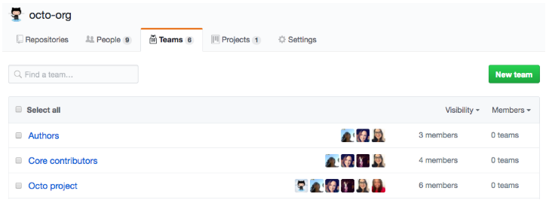
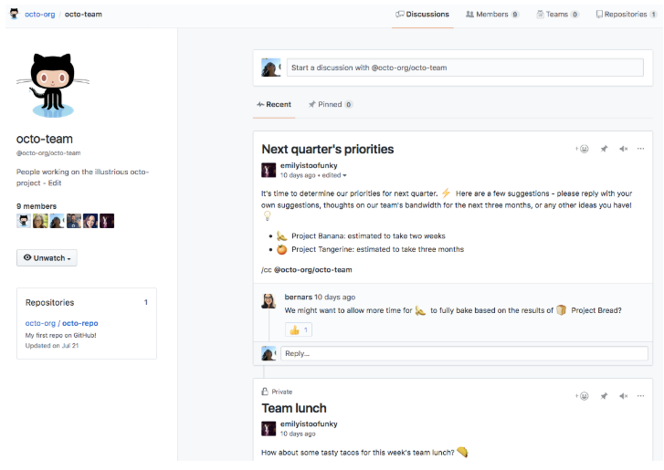
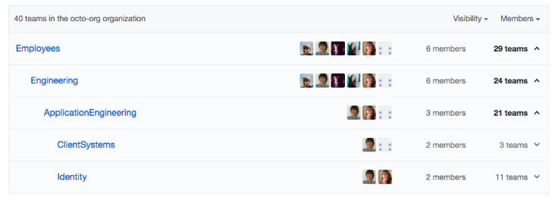
Team
Teams are groups of organization members that reflect your company or group's structure with cascading access permissions and mentions.
Organization owners and team maintainers can give teams admin, read, or write access to organization repositories
Organization members can
Send a notification to an entire team by mentioning the team's name
Can also send a notification to an entire team by requesting a review from that team
Request reviews from specific teams with read access to the repository where the pull request is opened
Teams can be designated as owners of certain types or areas of code in a CODEOWNERS file.
Team
Visibility
Teams can be visible or secret
Visible teams can be viewed and mentioned by every organization member
Secret teams are only visible to the people on the team and people with owner permissions
Each team has its own page within an organization
On a team's page, you can view team members, child teams, and the team's repositories
Organization owners and team maintainers can access team settings and update the team's description and profile picture from the team's page
Team
Pages
You can reflect your group or company's hierarchy within your GitHub organization with multiple levels of nested teams
A parent team can have multiple child teams, while each child team only has one parent team
You cannot nest secret teams
Nested
Teams

Slide 17
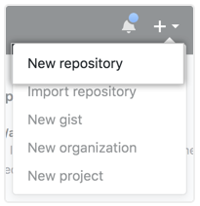
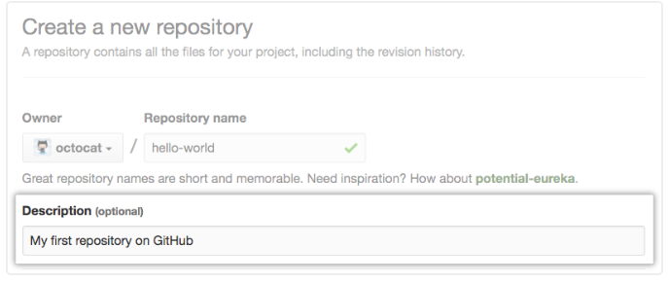
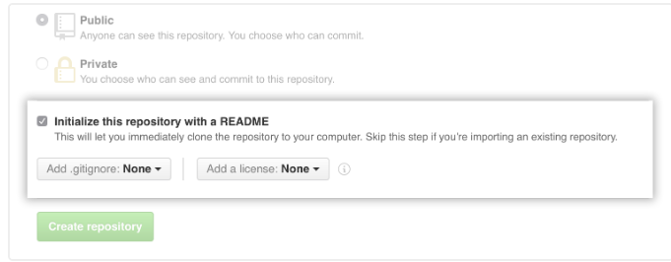
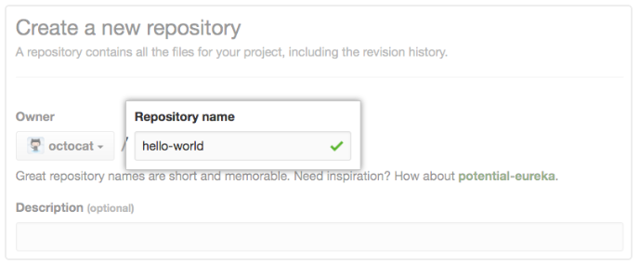
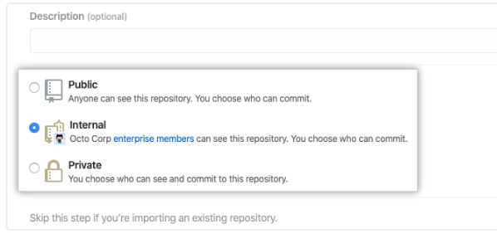
Creating Repository
Steps to create new Repository
Demo
In the upper-right corner of any page, use the drop-down menu, and select New repository
Type a short, memorable name for your repository. For example, "hello-world"
1
3
Choose a repository visibility. For more information, see "About repository visibility.“ and click “Create Repository”
5
Type a short, memorable name for your repository. For example, "hello-world"
Choose a repository visibility. For more information, see "About repository visibility."
2
4

Slide 18
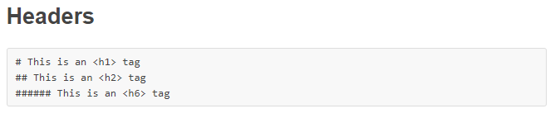
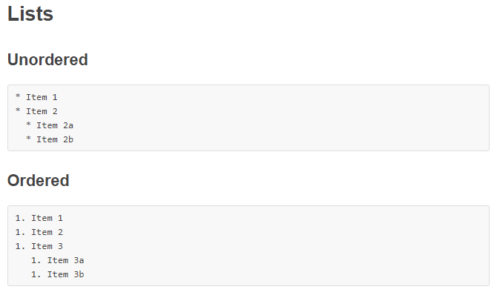
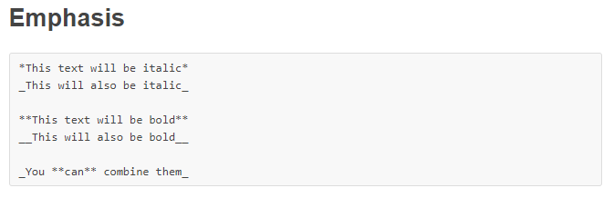
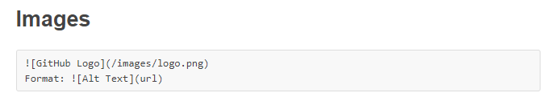
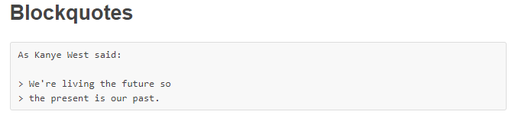
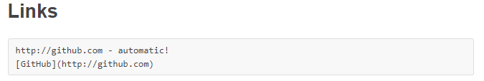
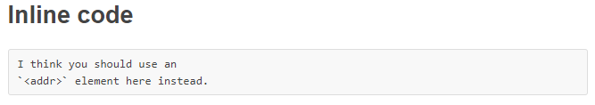
Markdown Overview
Markdown
Markdown is a way to style text on the web. You control the display of the document; formatting words as bold or italic, adding images, and creating lists are just a few of the things we can do with Markdown. Mostly, Markdown is just regular text with a few non-alphabetic characters thrown in, like # or *
Syntax Guide

Slide 19
SSH Key sharing
Generating a new SSH key
SSH
Key
sharing
Adding your SSH key to the ssh-agent
Adding a new SSH key to your GitHub account

Slide 20
SSH Key sharing
1.Generating a new SSH key
1.Open Git Bash. 2.Paste the text below, substituting in your GitHub email address. $ ssh-keygen -t rsa -b 4096 -C "your_email@example.com" This creates a new ssh key, using the provided email as a label. > Generating public/private rsa key pair. 3.When you're prompted to "Enter a file in which to save the key," press Enter. This accepts the default file location. > Enter a file in which to save the key (/c/Users/you/.ssh/id_rsa):[Press enter] 4.> Enter passphrase (empty for no passphrase): [Type a passphrase] > Enter same passphrase again: [Type passphrase again]
Ensure the ssh-agent is running: # start the ssh-agent in the background $ eval $(ssh-agent -s) > Agent pid 59566 Add your SSH private key to the ssh-agent. $ ssh-add ~/.ssh/id_rsa
2.Adding your SSH key to the ssh-agent

Slide 21
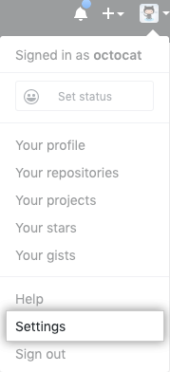
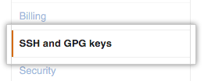
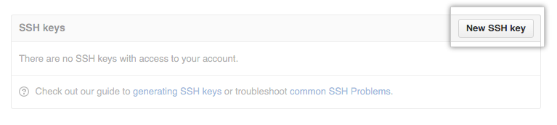
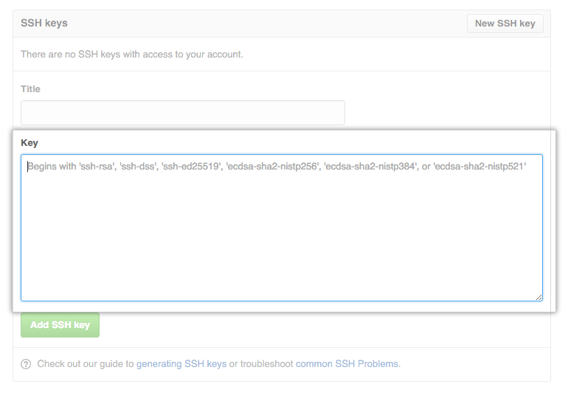

SSH Key sharing
3.Adding a new SSH key to your GitHub account
1.Copy the SSH key to your clipboard. 2. In the upper-right corner of any page, click your profile photo, then click Settings.

Slide 22
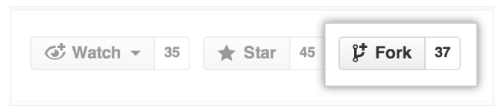
Fork, Cloning
Demo
Fork
Git Clone
Steps to Clone
Creating a “fork” is producing a personal copy of someone else’s project.
Forks act as a sort of bridge between the original repository and your personal copy.
You can submit Pull Requests to help make other people’s projects better by offering your changes up to the original project.
Forking is at the core of social coding at GitHub
Git clone is a Git command line utility which is used to target an existing repository and create a clone, or copy of the target repository
git clone ssh://john@example.com/path/to/my-project.git cd my-project # Start working on the project
Cloning to a specific folder
git clone <repo> <directory>
Usage
Cloning to a specific tag
Primarily used to point to an existing repo and make a clone or copy of that repo at in a new directory, at another location
The original repository can be located on the local file system or on remote machine accessible supported protocols
The git clone command copies an existing Git repository
This is sort of like SVN checkout, except the “working copy” is a full-fledged Git repository—it has its own history, manages its own files, and is a completely isolated environment from the original repository
git clone --branch <tag> <repo>
Shallow Clone – useful for repo with large history of commit
git clone -depth=1 <repo>
To fork the Spoon-Knife repository, click the Fork button in the header of the repository
Configuration Options
git clone a specific branch only
git clone -branch new_feature git://remoterepository.git
git clone -template
git clone --template=<template_directory> <repo location>

Slide 23
Fetch and Pull
Demo
git-fetch - Download objects and refs from another repository
git fetch to retrieve new work done by other people. Fetching from a repository grabs all the new remote-tracking branches and tags without merging those changes into your own branches.
GIT Fetch Syntax:
$ git fetch< repository Url>
To fetch a specific branch:
$ git fetch <branch URL><branch name>
To fetch all the branches simultaneously:
$ git fetch -all
To synchronize the local repository:
$ git fetch origin
git merge , which applies changes taken from fetch to a branch on your local repo.
Syntax: $ git merge
GIT Merge:

Slide 24
Branching and Merging
Demo
1. What are branches
2. How to create branch
3. How to checkout branch
4. How to merge branch to master
5. How to delete branch (local and remote)
Example: Creating one new branch and adding one file to new branch, then merging with master branch.
Step 1 : Create branch
git branch “branch name”
Step 2 : Checkout branch
git checkout “branch name”
Step 3 : Merge new branch in master branch
git merge “branch name”
Step 4 : Delete branch
git branch -d “branch name” — delete from local
git push origin —delete “branch name” — delete from remote

Slide 25
Idle Branching Strategy
Obviously there is no single branching strategy fits for all, it should be carefully crafted according to various aspects of the product delivery. Some of the key aspects are release frequency, team distribution, type of application, development methodology.
Feature Based Branching
Master branch - which always reflects production ready code
Feature branch - which contains any latest features worked out by the team
HotFix branch - created from Master branch to work on production issues and merged back to Master
Release Based Branching
Master branch - which always reflects production deployed code
Develop branch - spun off from Master, Long living parallel branch contains latest code changes, merged back to Production (or) Release when code changes ready for production release
HotFix branch - created from Master branch to work on production issues and merged back to Master and Develop
Release branch - Optionally created when code is almost ready for production release, merged back to Master and Develop, removed once production release is complete
Feature branch - spun off from Develop branch when working on POC, upon successful it gets merged back to Develop and removed

Slide 26
Git CheckOut
In Git terms, a "checkout" is the act of switching between different versions of a target entity
The Git checkout command operates upon three distinct entities: files, commits, and branches. In addition to the definition of "checkout" the phrase "checking out" is commonly used to imply the act of executing the Git checkout command
Checkout Existing Branch
Checkout Remote Branch
$> git branch -v
$> git checkout feature_inprogress_branch
git fetch --all
git checkout <remotebranch>
Checkout New Branches
git checkout <remotebranch> origin/<remotebranch>
git checkout -b <branchname>
git reset --hard origin/<branchname>
git checkout -b <new-branch>
git checkout -b <new-branch> <existing-branch>
Switching Branches
git checkout <branchname>

Slide 27
Commit changes
1
On your computer, move the file you'd like to upload to GitHub into the local directory that was created when you cloned the repository.
2
Open Git Bash..
3
Change the current working directory to your local repository.
4
Stage the file for commit to your local repository.
$ git add .
# Adds the file to your local repository and stages it for commit. To unstage a file, use 'git reset HEAD YOUR-FILE'.
5
Commit the file that you've staged in your local repository.
$ git commit -m "Add existing file"
# Commits the tracked changes and prepares them to be pushed to a remote repository. To remove this commit and modify the file, use 'git reset --soft HEAD~1' and commit and add the file again.
6
Push the changes in your local repository to GitHub
$ git push origin your-branch
# Pushes the changes in your local repository up to the remote repository you specified as the origin

Slide 28
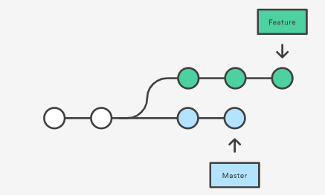
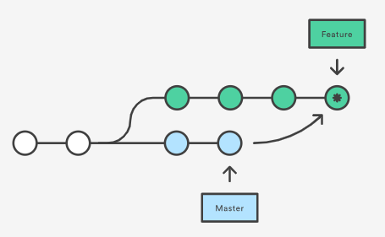
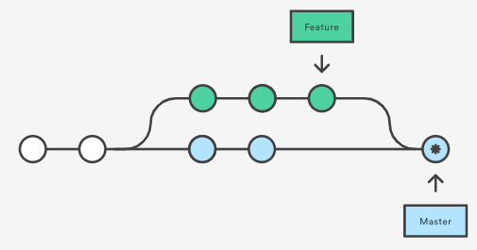
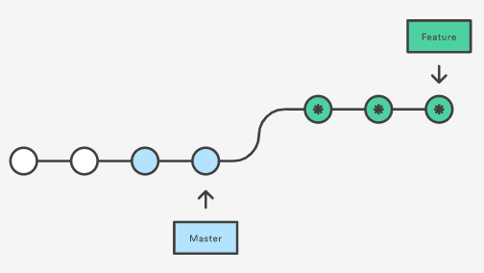
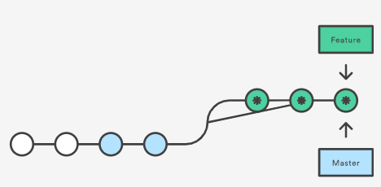
Type of Merges
Feature branching
Merge commit
Master branch after merge
Rebase Merge
Rebase and Merge

Slide 29
GIT Push
Demo
The "git push" command is used to push into the repository. The push command can be considered as a tool to transfer commits between local and remote repositories.
Syntax:
$ git push origin master
$ git push --force <REMOTE-NAME> <BRANCH-NAME>
GIT PULL:
Pull is used to update your current HEAD branch with the latest changes from the remote server.
git pull = git fetch + git merge
Syntax:
$ git pull
$ git pull <remote branch URL>

Slide 30
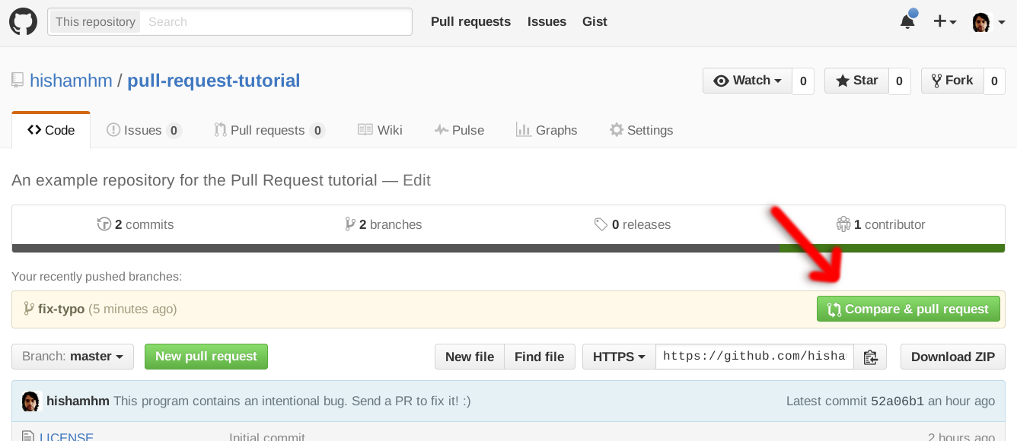
Opening pull request
Step 1 – Fork the repository from main branch
Step 2 – Download your fork and Make your changes in your fork
Step 3 – Commit and push the changes into your local git repository
Step 4 –Make the Pull Request

Slide 31
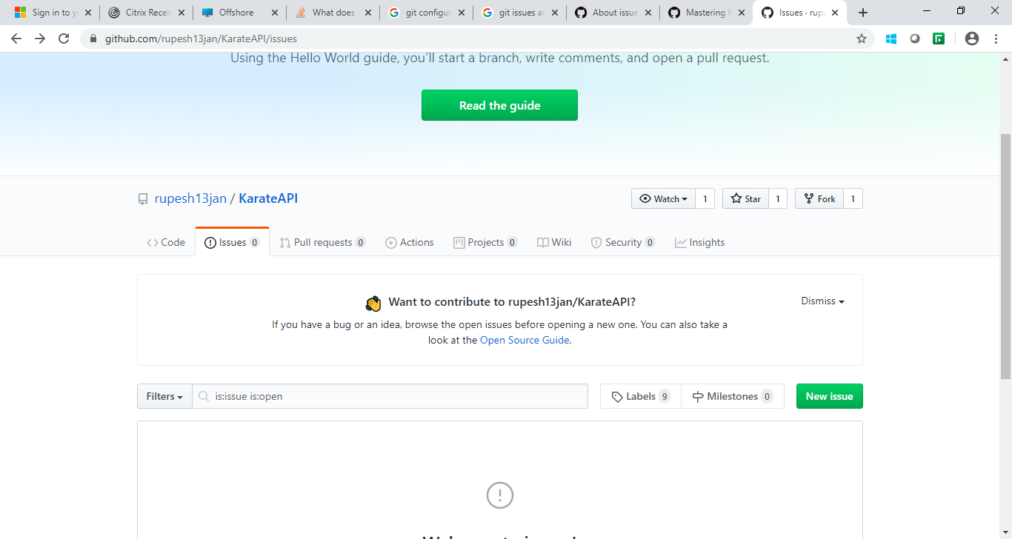
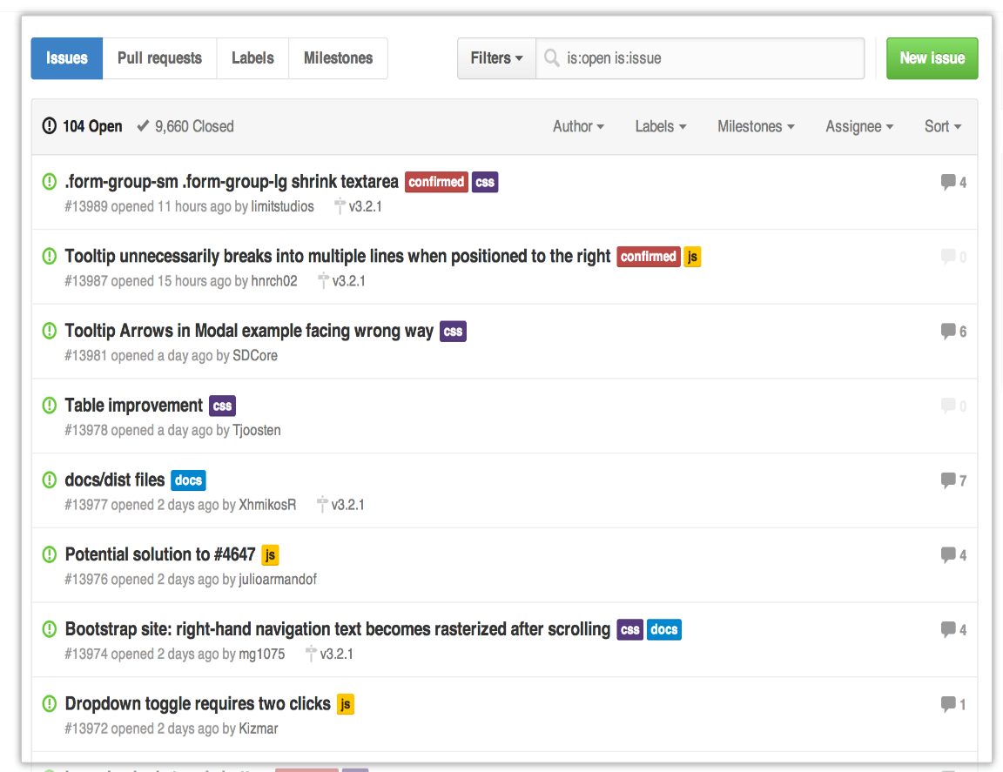
GitHub Issues
Demo
Git Issues are a great way to keep track of tasks, enhancements, and bugs for your projects

Slide 32
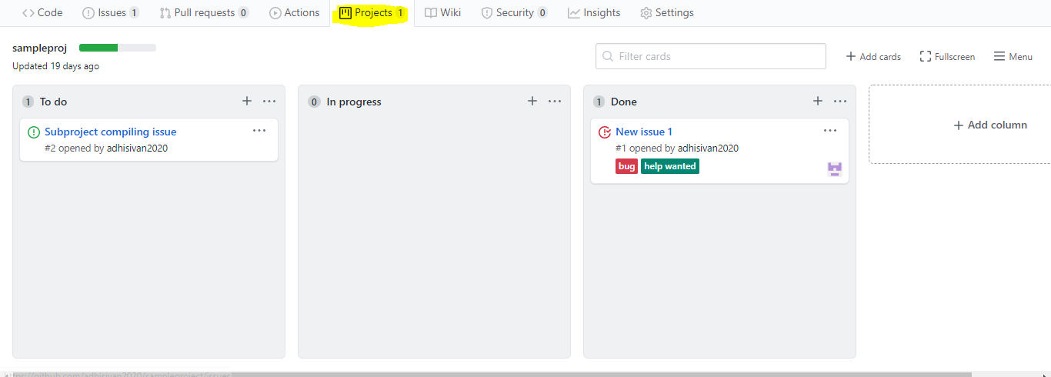
Project Kanban dashboard
Demo
Projects – Kanban board to coordinate, track and update work items.

Slide 33
Recommended eBooks and links
Pro Git – Second Edition
OReillly – Version control with Git
www.git-scm.com/docs - Git Guide
https://developer.github.com/v3/ - GitHub API link
https://help.github.com/en/github/getting-started-with-github/git-cheatsheet

Slide 34
Thank You

